Slide 1

.
PROLONGED PRESERVATION OF HUMAN LIVER USING NORMOTHERMIC MACHINE PERFUSION PROCESS
TEAM MEMBERS
VISHWA B
YUVAPRABHA B
PRADEEP V
SUBHASH P
SANJEEVADHARSH B R

Slide 2
Working Principle- Normothermic Perfusion
It is used in the field of Organ Transplantation to preserve and assess Human Organs
Normothermic Perfusion maintains Normal Temperature,Essential Substrates for Cellular Metabolism,Oxygen and Nutrition.
It provides continuous organ assessment for Real time Monitoring of Organ Function and Viability.

Slide 3
Features of PNMP
PNMP Preserves and assesses discarded human livers for Transplantation
Cold storage methods have limitations leading to the discard of viable organs
PNMP involves conditions oxygenated perfusion at normal Body Temperature

Slide 4
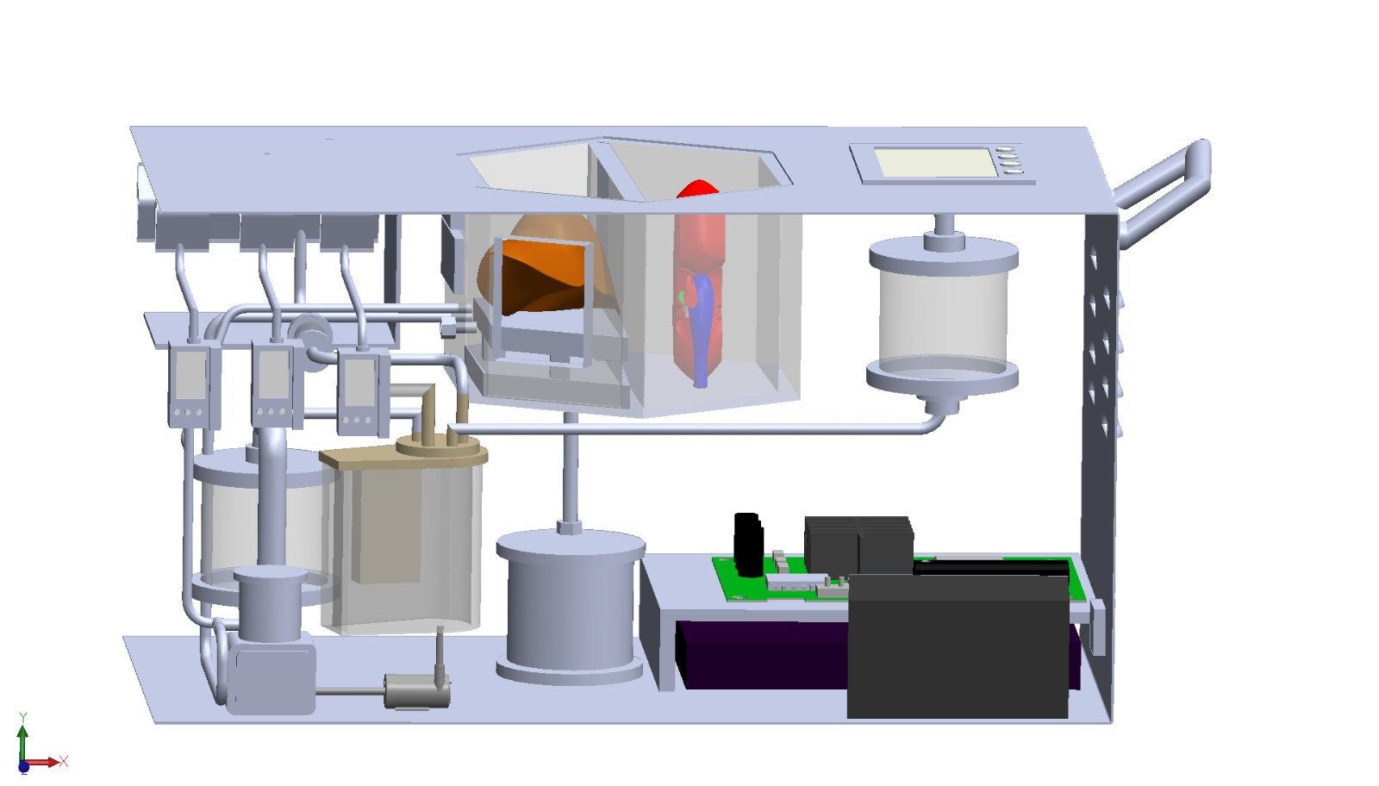
LIVER PRESERVATION KIT
.

Slide 5
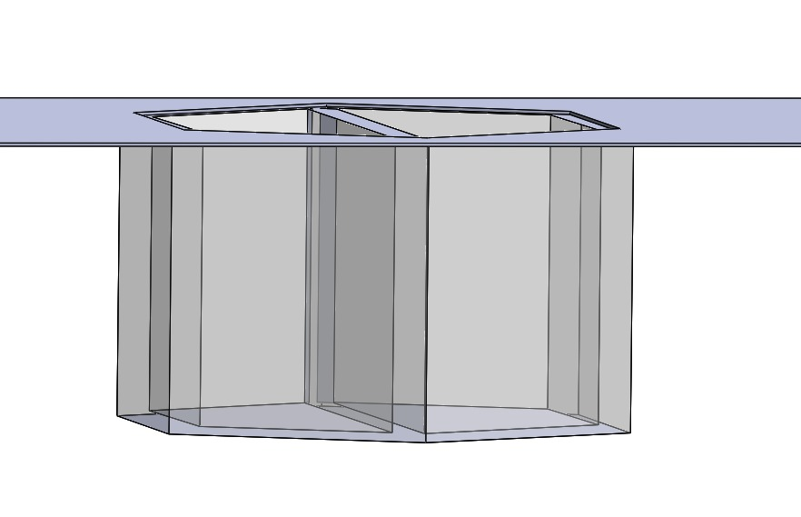
Components Used:
Organ Basin
Organ Basin:
Used to hold the Organs and protects the organs from Physical Trauma.
.

Slide 6
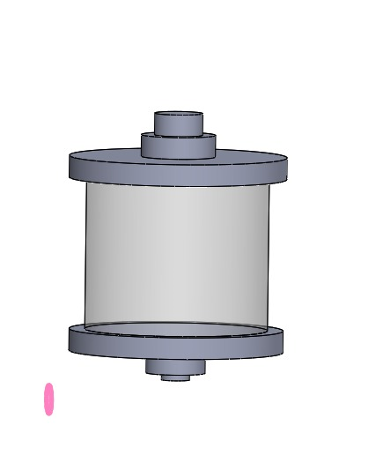
CLEANSER UNIT
Responsible for Cleaning and Filtering the organ Basin before and after it is used to preserve the organ.
Cleanser unit typically consists of filters and purification mechanisms that remove the unwanted particles,Bacteria and Other Contaminants from the Basin
.
.
CLEANSER UNIT

Slide 7
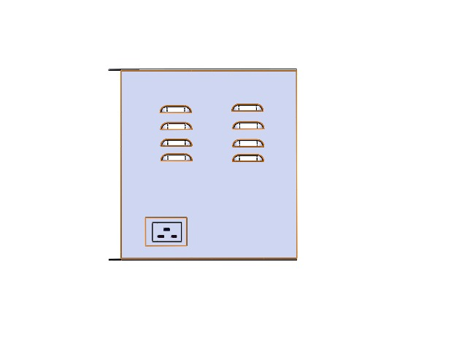
AIR FILTERS
.
Air Filters remove the Carbondioxide and other waste gases from the perfusion System
It Maintains the Sterile Environment for the organ during the Perfusion Process.
AIR FILTER

Slide 8
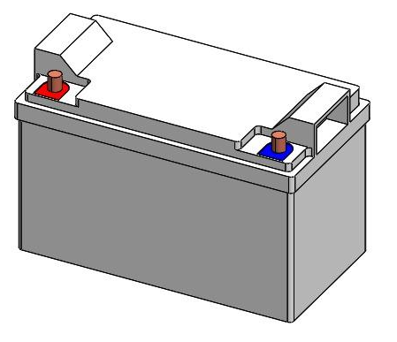
PMS UNIT
Power Management System Unit is Responsible for Managing and Supplying Power to Machine Perfusion Process.
It includes Power Sources,Voltage Regulator and Circuit Protection components.
.

Slide 9
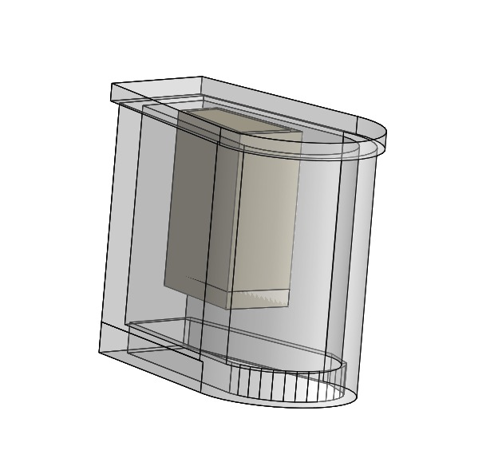
Heaters
Heaters are designed to keep the organs at a specific Temperature during Transportation from the donar to the Recipient
.
HEATER

Slide 10
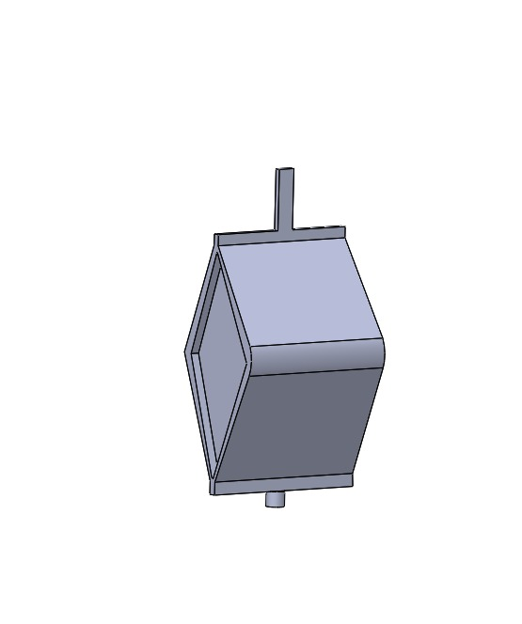
Reservoir
This Reservoir is designed to store and Protect the Liver during Transportation from the donal to the recipient.
The preservation Fluid such as University of Wisconsin(UW) Solution or Euro-Collins Solution is used.
.
RESERVOIR

Slide 11
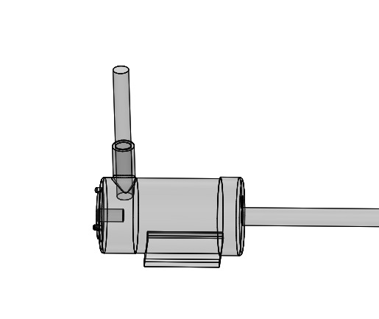
ROTAFLOW PUMP
Rotaflow Pump is a Medical Device designed for Extracorporeal Life Support Systems(ECLS) such as Extracorporeal Membrane Oxygenation(ECMO)
Operates in the Principle of Centrifugal Force to facilitate the movement of blood or other Fluid through pump.
.

Slide 12
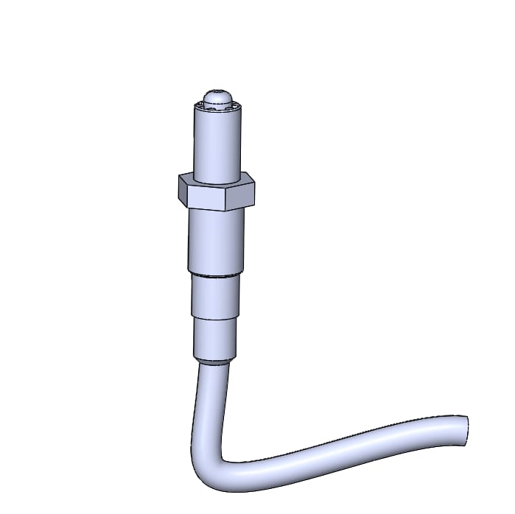
IV INFUSION PUMP
Used to deliver a Therapeutic solutions to the Preserved organs ensuring it receives essential Nutrients and Medications to maintain its Function during the Perfusion Process.
.

Slide 13
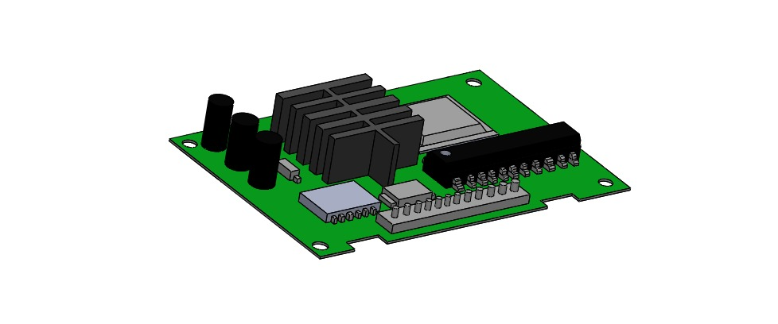
PV Pressure Monitor
Used to measure the Pressure Within the portal veins.
Changes in PV Pressure Indicate the Vascular Resistance and Congestion.
.

Slide 14
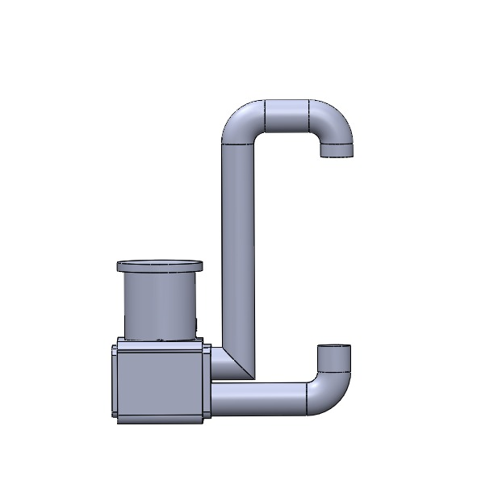
Medication Probe
Used to dilate the Blood vessels and improve Blood Flow through the organ.
It maintains the Organ Functions and Reduce the risk of Ischemia
.

Slide 15
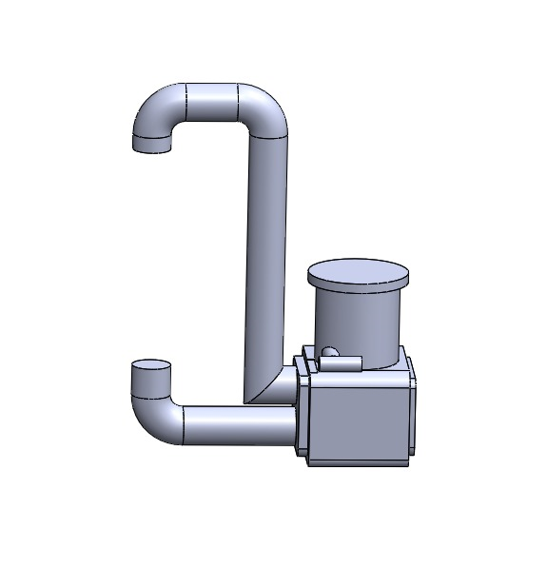
PV Infection
The discarded human organ is connected to perfusion machine through its blood vessels,Including the portal vein.
The perfusion machine can deliver oxygen,Nutrients and other essential substances to the Organ.
.

Slide 16
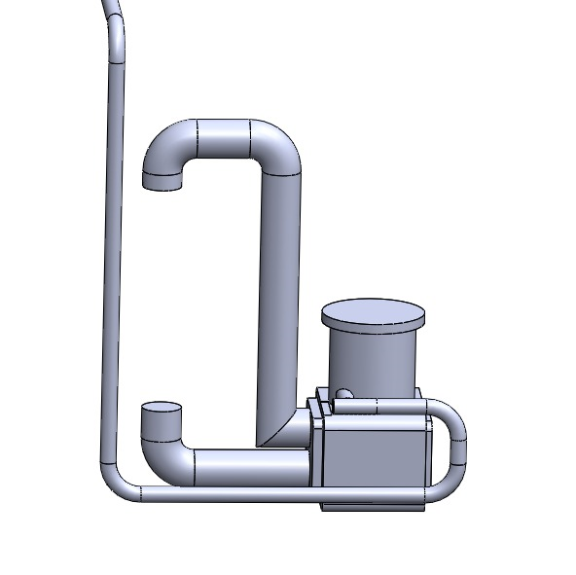
HA Infusion
It reduces the Inflammation and oxidative Stress during Organ Preservation,potentialy improve Organ function.
It is a hydsrophilic molecule which helps to maintain tissue hydration during PNMP.
.

Slide 17
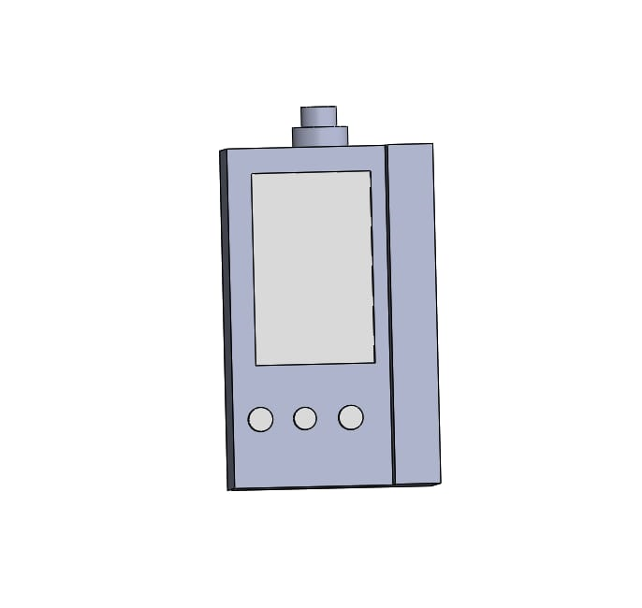
AUXILIARY PORT
Allow medical Professional to take Samples of the Perfusion Solution
Used to connect Various Monitoring devices to measure parameters such as Oxygen levels,Pressure and Temperature.
.

Slide 18
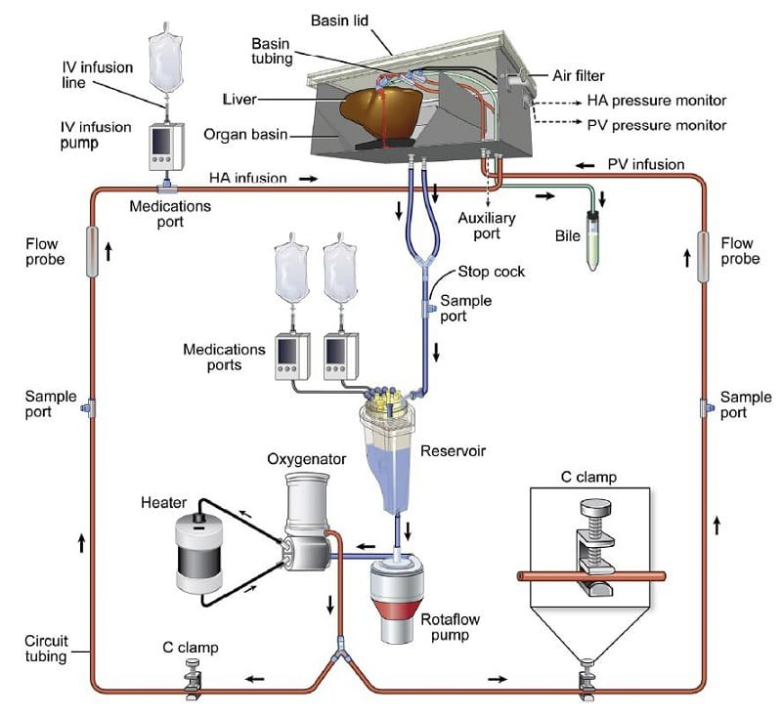
Work Flow

Slide 19
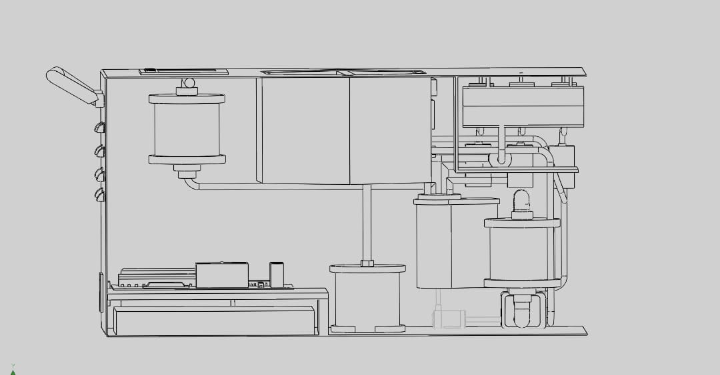
Design Process: Step 1 - Creating Sketch

Slide 20
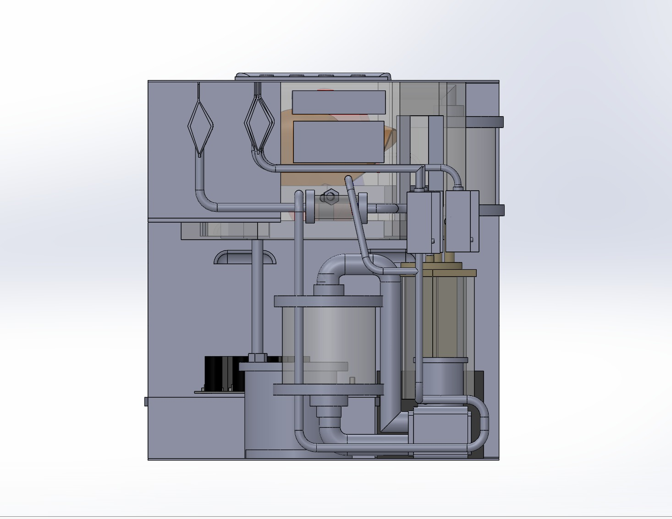
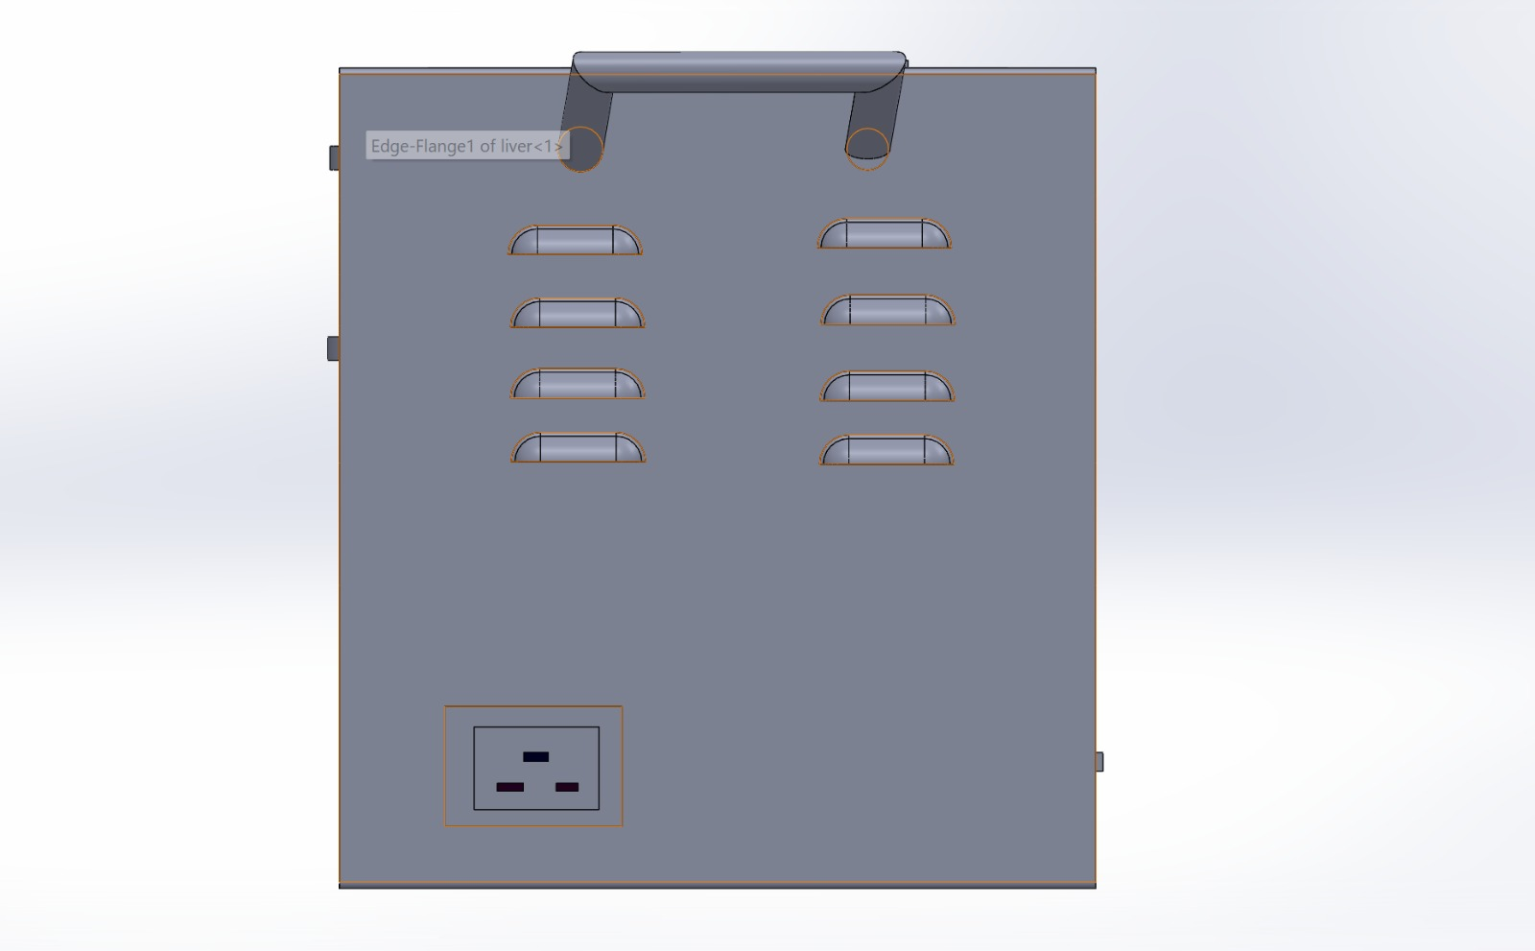
Step 2- Converting Sketch into Body
.
.

Slide 21
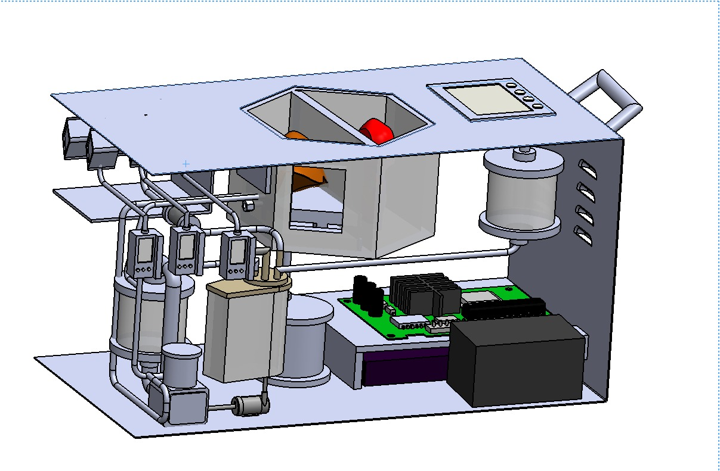
Step -3 Assembling the Components

